Slide 1
Policy for Progress:
Federal Agenda and the Fight Against Project 2025
Presentation for ACE
Facilitator: Tara Murray, Executive Director, National Urban League Washington Bureau (TMURRAY@NUL.ORG)

Slide 2
URGENT CIVIL RIGHTS ACTIONS
FOR THE LAME DUCK SESSION
Lame Duck Civil Rights Policy Priorities

Slide 3

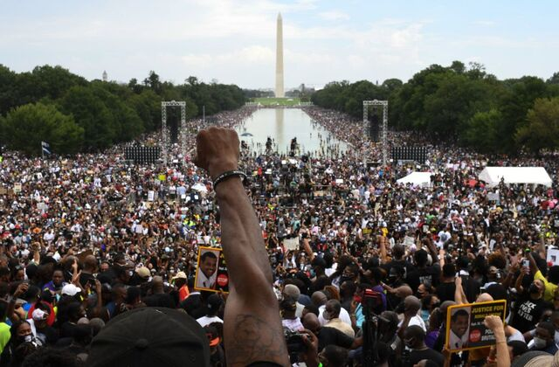
Fixing a Broken Democracy:
PROTECTING VOTING RIGHTS:
  John Lewis Voting Rights
  Advancement Act
  Freedom to Vote Act
JUDICIAL NOMINATIONS/FAIR COURTS
PUBLIC SAFETY & JUSTICE REFORM:
  George Floyd Justice in Policing
  Act
  Allocation of federal resources to
  protect communities against
  hate-based violence

Slide 4


Diversity as a Strength:
PROMOTING EQUITY & ACCESS:
  Safeguard diversity initiatives in
  education and workplaces
  Promote equitable hiring practices
  and address systemic barriers
  Federal workforce diversity
REPAIRING HARMS:
  Support policies that address
  systemic racism in housing, education,
  and employment

Slide 5

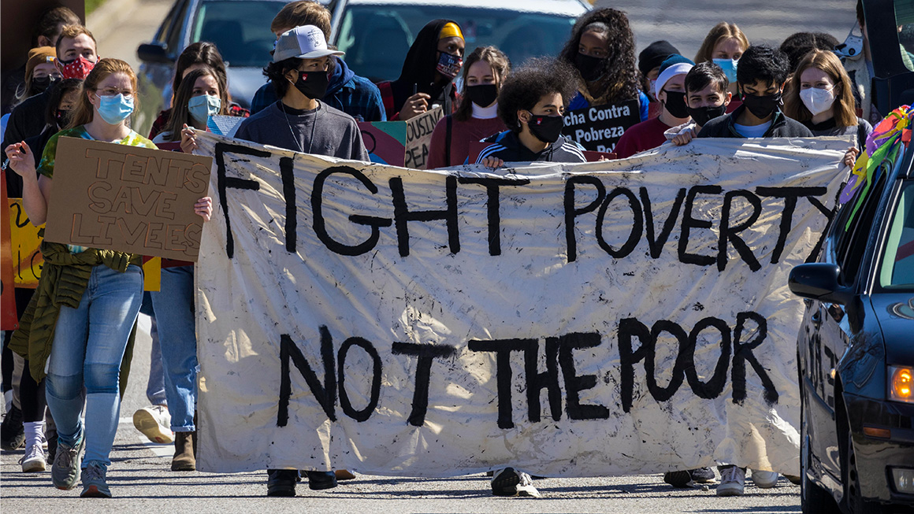
Empowerment Through Economic
Opportunity:
WEALTH CREATION
  Advancing digital equity
  Expanded access to financial services
AFFORDABLE HOUSING & HOME
OWNERSHIP
EXPANDING ACCESS TO QUALITY
HEALTHCARE
WORKFORCE DEVELOPMENT
SMALL BUSINESS SUPPORT
SOCIAL SAFETY NET EXPANSION
  Earned Income Tax Credit (EITC)
  Child Tax Credit (CTC)
  ACA tax credits

Slide 6
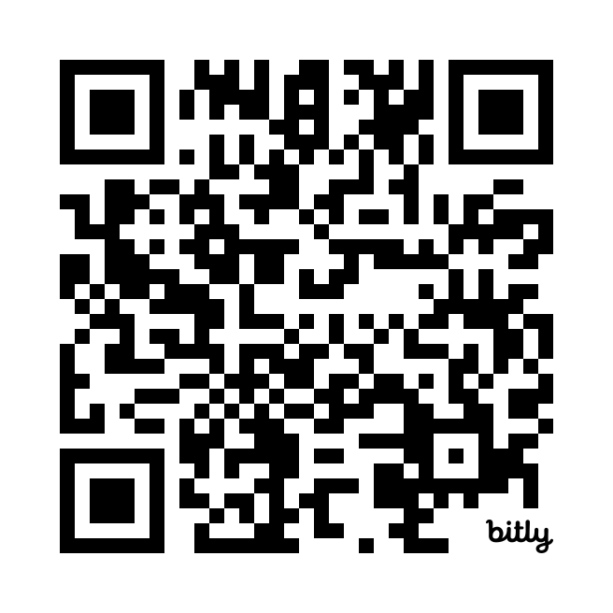
WE WANT TO WORK WITH YOU ON POLICY ADVOCACY…

Slide 7
Project 2025:
What You Need to Know and How We Will Win!

Slide 8

WHAT IS PROJECT 2025?
Authored by
‘Mandate for Leadership 2025: The Conservative Promise’, better known as Project 2025, is a 900 + page, radical right-wing playbook that details an insidious plan to transform America into an authoritarian government focused on:
Christian Nationalist Principles
Radical Right-Wing Policy
White Supremacy
Overview
Heritage Foundation
Well-funded right-wing think-tank
Advocates for a policy agenda in favor of:
  Free Enterprise
  Limited Government
  Traditional American Values
  Strong National Defense
Key Supporters
$22+
Million
Funds in Support
100+ Conservative Organizations
High Profile Conservative Leaders
Notes:
What is it? A controversial highly conservative 900-page initiative that establishes plans to transform the United States from a democratic country to an authoritarian system. A government that rules with one strong power and greatly limits political freedom and oppositions. Essentially, forcing the country to conform to a Christian Nationalist and White Supremist modern day society, removing rights for any opposing group of people.

Slide 9




ELEMENTS OF THE PROJECT 2025 PLAYBOOK
Political Agenda
Personnel
Training
180 Day Plan
Presidential power over other branches of government. No "checks & balances"
Presidential Immunity
Dismantling federal agencies and key safety net programs
Judicial activism
Tenured civil servants replaced with hand-picked right-wing loyalists
Loyalists will infiltrate all branches of government at the local, state, and federal levels to ensure compliance with presidential orders and identify political opponents
Creation of the Presidential Administration Academy
Onboarding Questionnaire
Project 2025 Plan Indoctrination
A whirlwind of policy and personnel change will take place during this timeframe
The administration will dismantle federal agencies, replace 50,000+ civil service employees with loyalists, and push right-wing policy
Notes:
The Project is divided into four pillars that each address strategies necessary to continue the implementation of Project 2025
Political Agenda –
Increased Presidential Power and Fiscal Conservatism: Project 2025 aims to rebuild the legislative branch to increase presidential control, emphasizing cutting taxes and federal funding.
Dismantling Federal Departments, Agencies, and Welfare Programs: Plans include shutting down or defunding key departments like Education, Labor, and Justice, reducing welfare programs and government services, impacting vulnerable groups.
Shift of Power to States and Disproportionate Access: While increasing the executive power, states will also have more control over their laws and policies, creating disproportions across the country
Personnel –
Replacing Civil Servants: Project 2025 plans to replace about 50,000 non-partisan civil servants with individuals who pledge allegiance to the conservative agenda, ensuring all staff align with the project's goals.
Handpicked Staff: Employees who support the conservative goals will undergo intense training, while those who do not will be fired and replaced with handpicked supporters. These supporters are determined through the “training” pillar discussed below. As well as an intensive questionnaire relating to the project’s mission.
Questionnaire Example: “Name the one public policy issue you are most passionate about. Why are you passionate about this issue and how would you like to see it addressed in the future?” This question shows their vetting system for distinguishing which candidates share an aligned interest.
Implementation at All Government Levels: Project 2025 is already in action, filling courts with conservative supporters at local, state, and national levels to facilitate passing legislation and furthering their agenda.
Training –
Presidential Administration Academy: To implement pillar 2, conservative supporters undergo online screening and classes via Presidential Administration Academy, which prepares them with the necessary tools to secure political positions, navigate media, and obtain security clearances in administrative positions.
The program vets individuals and determines who is fit to progress their plans by training them in conservative government tactics.
180-Day Playbook
The 180-day plan is the agenda and goals the next president will set and follow in the first six months of their term. It is set by every President as they enter office. In Trump’s previous term he got 60% of his 180-day done.
Project 2025 is focusing on consolidating executive power, dismantling federal agencies, and implementing far-right policies quickly to reshape the federal government and its operations.

Slide 10

How is Project 2025 Already at Play?

Slide 11

How Project 2025 was Hidden in Plain Sight
Project 2025 is not a new plan, in fact, the far right has pushed similar agendas for the past 40 years, most notable during the last presidential administration! Some actions carried out during the last administration that align with proposals from Project 2025 include:
Stacking the Supreme Court with radical far-right justices
Failing to condemn/turning a blind eye to/actively encouraging white supremacist violence and political violence (e.g., Charlottesville, January 6th Attack on the U.S. Capitol)
Racially-Motivated Immigration Bans and Travel Policies
“Our Freedom is at Stake,
Stop Project 2025!"

Slide 12

CORRUPTION OF THE COURTS
Unchecked Power of the Supreme Court
Project 2025 will continue the current agenda of taking far right control of the courts at the local, state, and federal levels by:
Appointing younger, more radical, federal court judges at all levels
Politicizing the SCOTUS, giving justices unchecked power to push the Project 2025 agenda and influence American policy for generations to come
Plan of Action
1) 2/3 of the SCOTUS ruled in favor of presidential immunity for "official acts"
3) Ensures Project 2025 legacy
remains intact for generations to come
2) Shift from a constitutional to a political body
Case Examples
New York State Rifle & Pistol Association Inc. v. Bruen
Dobbs v. Jackson Women's Health Organization
Students for Fair Admissions v. UNC & Harvard
Alexander v. South Carolina State Conference of NAACP

Slide 13
SHIFTING CONGRESSIONAL IDEOLOGY
Currently, more than 30 members of Congress have received the Heritage Foundation's 100% approval rating, which means they are in COMPLETE alignment with the Project 2025 agenda.
195 current members of Congress (36.4% of voting members) are identified as at least 60% aligned with Heritage Foundation legislation.
...and MORE are on the way! The goal of Project 2025 is to put as many radical loyalists as possible in the U.S. Congress EVERY election cycle!
These members of Congress have PLEDGED ALLEGIANCE to the Project 2025 policy platform agenda...NOT to the principles of democracy or their constituents, who they took an oath of office to serve and represent!
Notes:
This link goes to the list of key votes according to the Heritage Foundation in the 118th Congress:
Scorecard 118 Key Votes | Heritage Action For America
This is detailed and good information, I just wasn’t sure about us linking this site.

Slide 14
118th CONGRESS MEMBERS 100% ALIGNED WITH PROJECT 2025*
Andrew Clyde (GA-09)
Ben Cline (VA-06)
Wesley Hunt (TX-38)
Andy Ogles (TN-05)
Cory Mills (FL-07)
SENATOR Mike Braun (IN)
Josh Brecheen (OK-02)
Eric Burlison (MO-07)
Michael Cloud (TX-27)
Mike Collins (GA-10)
Byron Donalds (FL-19)
Bob Good (VA-05)
Paul Gosar (AZ-04)
Harriet Hageman (WY)
Diana Harshbarger (TN-01)
Debbie Lesko (AZ-08)
Tracey Mann (KS-01)
Mary Miller (IL-15)
Ralph Norman (SC-05)
Bill Posey (FL-08)
John Rose (TN-06)
Matt Rosendale (MT-02)
Chip Roy (TX-21)
Keith Self (TX-03)
Tom Tiffany (WI-07)
William Timmons (SC-04)
Randy Weber (TX-14)
Mike Johnson (LA-04)
Marjorie Taylor Greene (GA-14)
Lauren Boebert (CO-03)
*According to the Heritage Foundation’s Official Record

Slide 15
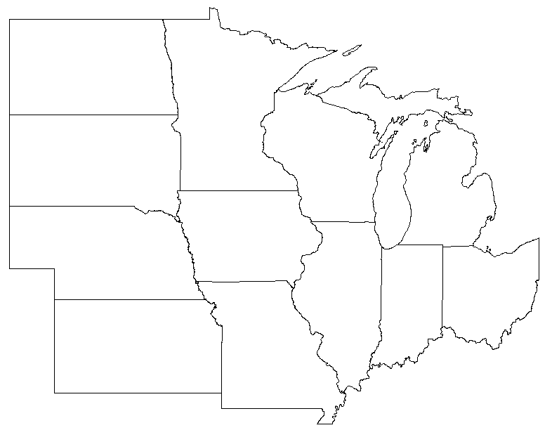
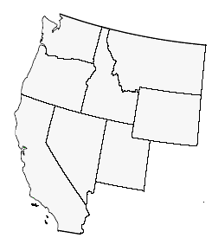
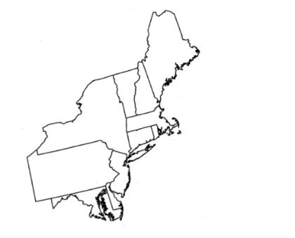
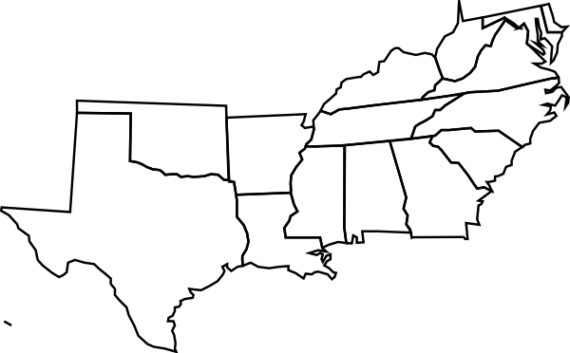
STATE & LOCAL AGENDA
Northeast
South
Mid-West
West Coast
An anti-LGBTQ+ bill was introduced to the Delaware legislature (SB 191; 2024)
  force transgender athletes to participate in the sport associated with their sex assigned at birth
New Jersey legislature has introduced several bills that would censor school curriculum (Bills A531, A670, & A2580; 2024)
  Would misinform students on civil rights and gender curriculum
Louisiana legislature passed a bill to display the Ten Commandments in every public classroom (HB71; 2024)
  Forces Christian nationalism into public education
Florida’s “Don’t Say Gay” bill prohibits “classroom discussion about sexual orientation or gender identity.” (HB1557; 2022)
  Stigmatizes LGBTQ+ identifying persons
Utah enacted a ban on DEI in government (HB261; 2024)
  Disallows the instruction of DEI in public education
  Bans government DEI programs
Arizona has banned abortions after 15 weeks (HB2677; 2022)
  No exceptions for rape or incest
Iowa bill censors public education (SF 2435; 2024)
  Restricts the development of DEI programs in institutions of higher education
Indiana has a near-total, “Trigger”, ban on abortions (SEA 1; 2022)
  Exceptions for first trimester Abortions & in case of rape or incest
Notes:
Less words

Slide 16
What is the Project 2025 Plan for the Next
Conservative Administration?

Slide 17

Education
Project 2025 plans to decentralize education control and promote conservative values by:
Dismantling the Department of Education
Removing Critical Race Theory and DEI Initiatives
Removing federal funding for public schools to provide more funding to private Christian-based institutions
Promotion of alternative education such as private, charter, Catholic, and home schools
Elimination of gender and transgender protection in school systems
"The fight to save diversity, equity, and inclusion is crucial to ensuring that our schools provide fair and equal opportunities for all students, regardless of their background."
~ NAN Founder Rev. Al Sharpton

Slide 18

Jobs & Workforce Development
Project 2025 aims to reduce federal oversight on the labor market and prioritize profitability of corporate enterprise by:
Diminishing worker protections & job quality
Restructuring of the Department of Labor to reduce worker rights and increase labor and safety violations
Repealing minimum wage laws
Establishing policies to undermine labor unions
Elimination of social security benefits for retirees
Increasing the retirement age for workers
Completely overhauling diversity initiatives in the workforce
”Poverty, the racial divide and social injustice do not impact only those who suffer most visibly. Alleviating poverty and injustice is a responsibility we must never forget or abandon.”
~ NUL President & CEO Marc Morial

Slide 19

Justice & Civic Engagement
By increasing the power of the Executive Branch, Project 2025 will implement policy to:
Reconstruct the Department of Justice and Federal Bureau of Investigation
Weaponize the U.S. military and national guard for political purposes
Reduce Civil Rights and the enforcement of anti-discrimination laws
Implement voter laws which make access to the ballot more difficult
Dismantle police reform efforts aimed to prevent law enforcement abuse
Grant presidential pardon to loyalists who abuse their power or violate the law
"The right to vote is the right upon which all of our rights are leveraged - and without which none can be protected."
~ Former NAACP President Ben Jealous

Slide 20

Housing
Project 2025 will promote private market solutions and dismantle fair housing and homeowner affordability by:
Reducing federal housing programs
Privatizing housing and deregulating the housing market
Elimination of Fair Housing Act protections against housing discrimination
Benefit higher income individuals through deregulation and tax incentives
Reducing environmental protection to increase housing development and support
big business
”Most people of color—a disproportionate share of African Americans, in particular—will continue to be renters unless meaningful policies address demographic shifts.”
~NUL President & CEO Marc Morial

Slide 21

Health and Wellness
Project 2025 aims to fundamentally change healthcare access and affordability by:
Elimination of health equity programs through reduced federal funding
Rolling back Medicaid, Medicare Affordable Care Act benefits
Privatization of healthcare services
Limiting access to STD testing, IVF programs, and contraception
Reducing reproductive options through nationwide abortion bans
Eliminating LGBTQ+ health protections
”In the wealthiest nation on Earth, no illness or accident should lead to any family’s financial ruin.”
~ Former President Barack Obama

Slide 22




HOW WILL PROJECT 2025 AFFECT YOUR EVERYDAY LIFE?
Women
Communities Of Color
Immigrants
LGBTQ+ Community
Little to no right over to their bodies, specifically reproductive health
  There will be no right to choose, with nationwide abortion restrictions
  No options for IVF
Less workplace and educational equity
Targeted by the removal of DEI in the workplace and education system
Widening of health disparities
Increased poverty rates among communities, increasing housing instability and the racial wealth gap
End of racial equity
Mass deportation and destruction of U.S. immigration system
Decreased visa approvals
Stricter border laws and dismantling the Department of Homeland Security
Fewer citizenship options for Dreamers and immigrants seeking asylum
Recognition of traditional one-man, one-woman households only
Restrict military enrollment for transgender persons
Remove transgender rights and demonize their existence
Implement conversion therapy plans

Slide 23
What Can You Do?
How Can You Get Involved?

Slide 24
HOW WE WILL WIN: FOCUS ON SOLUTIONS
People must stand together:
Voter education and voter registration for the upcoming elections
Vote at every position, every election
Continue to advocate for voting rights, expanded voter eligibility, and access to the ballot
Knowledge is Power:
Continue to talk about Project 2025 and let everyone know its dangers
Foster community through town halls, small groups, and other partnerships
Expand your reach through webinars, social media, and other digital platforms
Election Engagement
Share Information
Notes:
Election Engagement: Since the next presidential election is currently underway, it is important that everyone takes time to understand the election. We must listen to debates, monitor polls, engage in election information sessions to learn more. We must also vote. It is important now more than ever; we vote for all levels of government. As well as ensure we are registered to vote and other friends and family are registered to vote.
Share Information One of the biggest tools we can use in preparation for Project 2025 is raising public awareness about the impacts of the project through media, public forums, and several education initiatives. Raising voter’s awareness about threats to democracy increases the chances that people vote against these changes.
Litigation As Applicable: There must be initiatives taken to promote legislative measures to protect federal institutions and prevent implementation of extreme policies. Combat their court presence by working within state governments, with advocacy groups, civil rights organizations, and courts to challenge harmful policy.
Legislation Advocacy: Working together with several pro-democracy organizations, civil right groups, and affect communicated to create plans to combat and prepare for Project 2025 through several techniques such as lobbying. One huge example of this is the recently created Stop Project 2025 Task Force. Spearheaded by Jared and joined by several congressmen and organizations, the task force looks at ways to work together in the face of Project 2025.

Slide 25
HOW WE WILL WIN: FOCUS ON SOLUTIONS
Be proactive:
Create and support legislation to counter Project 2025
Build strong coalitions with likeminded advocates now
Develop policy that counteracts radical principles that are based upon justice, equity, inclusivity, and more
Preparation is the key to success:
Be ready to file lawsuits against unconstitutional policies
Create programs to provide legal support to those impacted by unjust policies
Advocate for federal monitoring and
reporting of violations
Litigation
Legislative Activism
Notes:
Election Engagement: Since the next presidential election is currently underway, it is important that everyone takes time to understand the election. We must listen to debates, monitor polls, engage in election information sessions to learn more. We must also vote. It is important now more than ever; we vote for all levels of government. As well as ensure we are registered to vote and other friends and family are registered to vote.
Share Information One of the biggest tools we can use in preparation for Project 2025 is raising public awareness about the impacts of the project through media, public forums, and several education initiatives. Raising voter’s awareness about threats to democracy increases the chances that people vote against these changes.
Litigation As Applicable: There must be initiatives taken to promote legislative measures to protect federal institutions and prevent implementation of extreme policies. Combat their court presence by working within state governments, with advocacy groups, civil rights organizations, and courts to challenge harmful policy.
Legislation Advocacy: Working together with several pro-democracy organizations, civil right groups, and affect communicated to create plans to combat and prepare for Project 2025 through several techniques such as lobbying. One huge example of this is the recently created Stop Project 2025 Task Force. Spearheaded by Jared and joined by several congressmen and organizations, the task force looks at ways to work together in the face of Project 2025.

Slide 26

Legislative Activism Example: Stop Project 2025 Task Force
Formed in June 2024, progressive members of Congress and advocacy organizations work to address and combat Project 2025 by:
Raising public awareness
Developing opposition strategies and legislation
Preparing a plan to fight the Project 2025 agenda beyond the 2024 election cycle
Congressional Membership
Led By Rep. Jared Huffman (CA-02)
What is it?
Democrat Support:
Diana DeGette (CO-01)
Mark Pocan (WI-02)
Ted Lieu (CA-36)
Pramila Jayapal (WA-07)
Nanette Diaz Barragan (CA-44)
Judy Chu (CA-28)
Jamie Raskin (MD-08)
Ayanna Pressley (MA-07)
This task force is a blueprint for legislative activism that can be implemented at the state and local levels, as well. We must bring together advocacy groups and democracy-focused lawmakers to STOP project 2025.
There is POWER in numbers!

Slide 27
REMEMBER!!!
We are well-positioned to WIN the fight to STOP Project 2025!
•We are the majority and we hold more power together!
•We must turn-out and vote to secure our democracy!
•We must take collective action to combat Project 2025 in all its forms at all levels of local, state, and national government!
Notes:
Emphasize: This is just another battle in a long fight, but a fight worth winning!
Far-right conservatives will not stop with this presidency or plan. There will always be a push to limit individual rights and freedoms. However, we must never stop working toward complete equity and equality! This is just one example of why it is so important to come together, vote, and pave the way for a country we want!

Slide 28
To learn more about STOP Project 2025, follow us on nul.org for updates!

Slide 29
Appendix
Presidential Personnel Database and Presidential Administration Academy Questionnaire
Time – What is Project 2025
Media Matters – A Guide to Project 2025, The extreme Right-Wing Agenda for the Next Republican Administration
Project 2025: A summary of Destruction of the United States
Project 2025 Explained
Project 2025: The Trump Presidency Wish List, Explained
Project 2025: What is the Far-Right Plan for a Trump Government?
What is Project 2025? The Presidential Transition Project Explained
Project 2025 promises to shut down Dept. of Education, ban abortion, roll back civil rights and more
Project 2025 Handbook
Democrats launch effort to counter conservatives’ sweeping ‘Project 2025’

Slide 30
Appendix Cont.
Texas Abortion "Trigger" Law Effective August 25th, 2022
What Florida's 'Don’t Say Gay' bill actually says (nbcnews.com)
Abortion Laws by State - Center for Reproductive Rights
Mapping Attacks on LGBTQ Rights in U.S. State Legislatures in 2024 | American Civil Liberties Union (aclu.org)
Bill Detail - Delaware General Assembly
Indiana will be 15th state to ban almost all abortions : Shots - Health News : NPR
Louisiana could become first state to require display of Ten Commandments in classrooms | CNN Politics
Gov. Reynolds Signs Several Bills into Law | Governor Kim Reynolds (iowa.gov)
Utah is the latest state to ban DEI efforts on campus and in government : NPR
Arizona Abortion Laws | Arizona Attorney General (azag.gov)

